Slide 1
Time Frequency Weighted Overlapping Group Shrinkage for Speech Denoising
Nimish Magre & Alex Epstein

Slide 2
Contents
Problem Statement and Motivation
Overlapping Group Shrinkage (OGS)
Weighting Modifications
Future Work

Slide 3
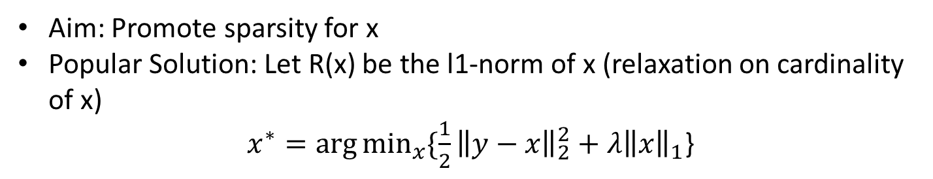
Problem Statement & Motivation:
Decomposition of noisy signal: $y\left(i\right)=x\left(i\right)+w\left(i\right), iεI and I=\{0,…,N−1\}$
Convex Optimization problem: $x^{∗}=\arg{\min_{x}{\{F\left(x\right)= \frac{1}{2}{\left\|y−x\right\|}_{2}^{2}+λR(x)}\} }$
Aim: Promote sparsity for x
Popular Solution: Let R(x) be the l1-norm of x (relaxation on cardinality of x)
$x^{∗}=\arg{\min_{x}{\{\frac{1}{2}{\left\|y−x\right\|}_{2}^{2}+λ{\left\|x\right\|}_{1}}}$}
Problem: Assumes each significant coefficients to be independent {sparsity does not get rid of residual noise}
Solution: Make use of prior structural knowledge:​
Promote Group¹ Sparsity: Correlation between groups of coefficients [significant values tend to not be isolated]
[1]: Juan Liu and P. Moulin, "Information-theoretic analysis of interscale and intrascale dependencies between image wavelet coefficients," in IEEE Transactions on Image Processing, vol. 10, no. 11, pp. 1647-1658, Nov. 2001, doi: 10.1109/83.967393.

Slide 4
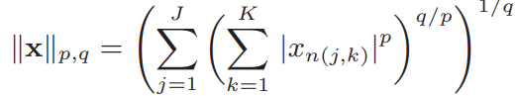
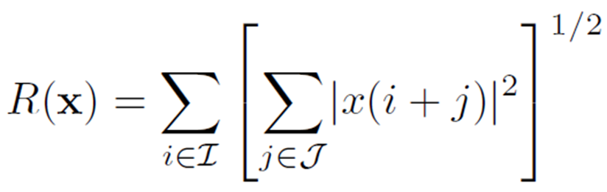
Overlapping Group Shrinkage (OGS)
Mixed norm non-separable penalty term to promote group-sparsity²:
[2]: Bayram, I., 2011, May. Mixed norms with overlapping groups as signal priors. In 2011 IEEE International Conference on Acoustics, Speech and Signal Processing (ICASSP) (pp. 4036-4039). IEEE.

Slide 5
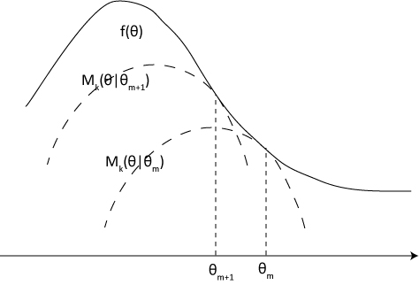
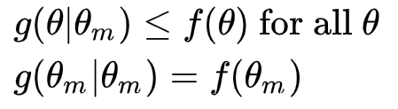
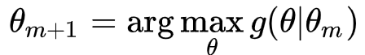
MM algorithm to iterative solve the optimization problem³
- Tangency
- Dominance
[3]: Kenneth Lange., 2007, April. The MM Algorithm, Departments of Biomathematics, Human Genetics, and Statistics,
UCLA, Berkeley

Slide 6
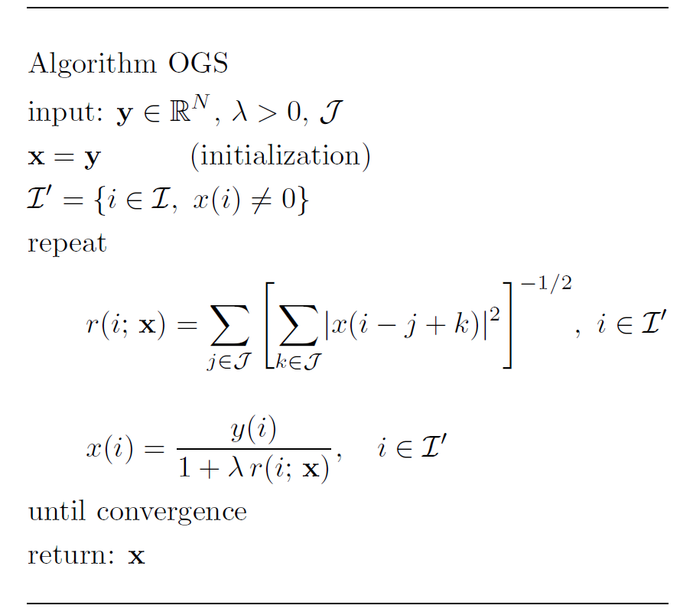
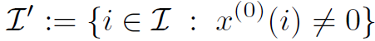
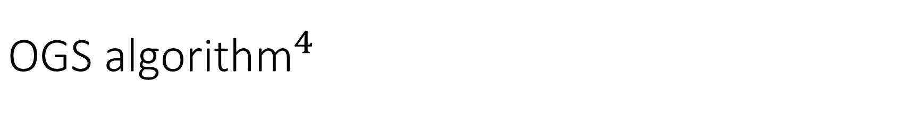
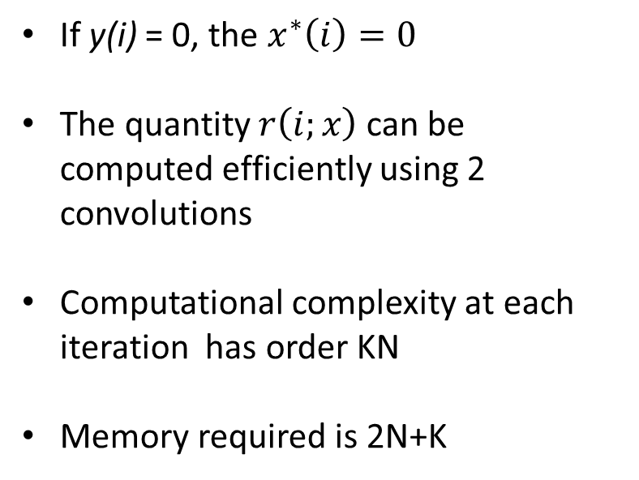
$${\text{OGS} \text{algorithm}}^{4}$$
If y(i) = 0, the $x^{∗}\left(i\right)=0$
The quantity $r\left(i;x\right)$ can be computed efficiently using 2 convolutions
Computational complexity at each iteration has order KN
Memory required is 2N+K
[4]: Chen, P. Y., & Selesnick, I. W. (2014). Translation-invariant shrinkage/thresholding of group sparse signals. Signal Processing, 94, 476-489.

Slide 7
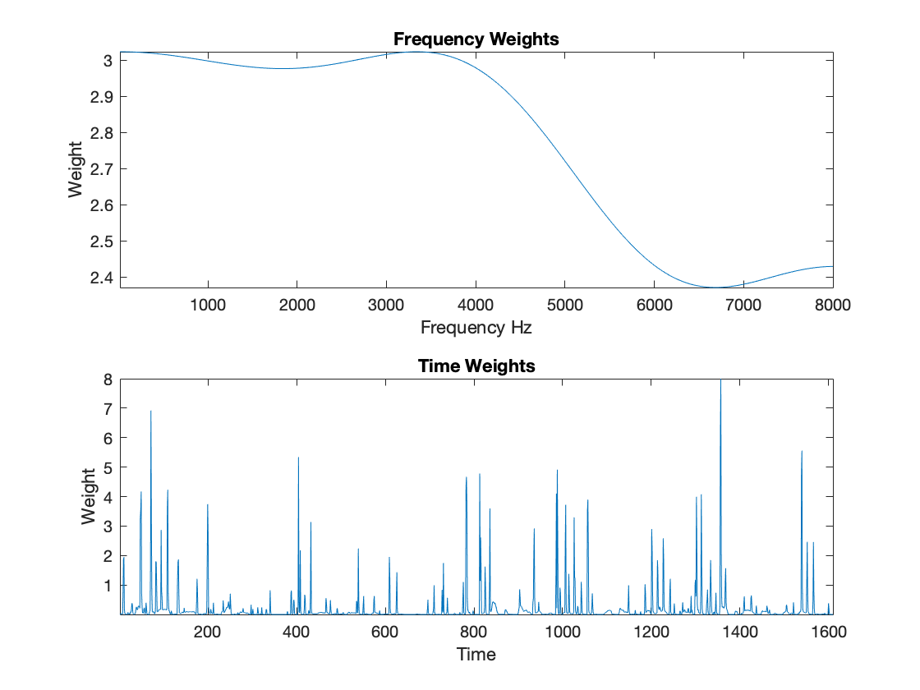
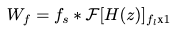
Frequency Weighting
Different levels of attenuation across frequency
Requires some apriori knowledge either about our noise or target signal
Scaling factor gives us knob to turn for importance of frequency weights
Only calculated once

Slide 8
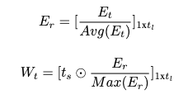
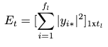
Time Weighting
Different levels of attenuation across time
Simple energy-based equation invariant to problem type
Scaling factor gives us knob to turn for importance of time weights
Only calculated once

Slide 9
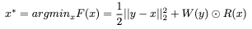
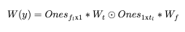
Modified Cost Function
Lambda has been replaced with weighting matrix
Weighting matrix performs elementwise multiplication accounting for the differences in both time & frequency

Slide 10

White Gaussian Noise Example
Clean Speech
Noisy Speech
OGS
TFOGS
SNR ∞
SNR –1 dB
SNR 8.2 dB
SNR 7.87 dB

Slide 11
Impulsive Noise Example
Clean Speech
Noisy Speech
OGS
TFOGS
SNR ∞
SNR –7.42 dB
SNR –3.8 dB
SNR 4.43 dB

Slide 12
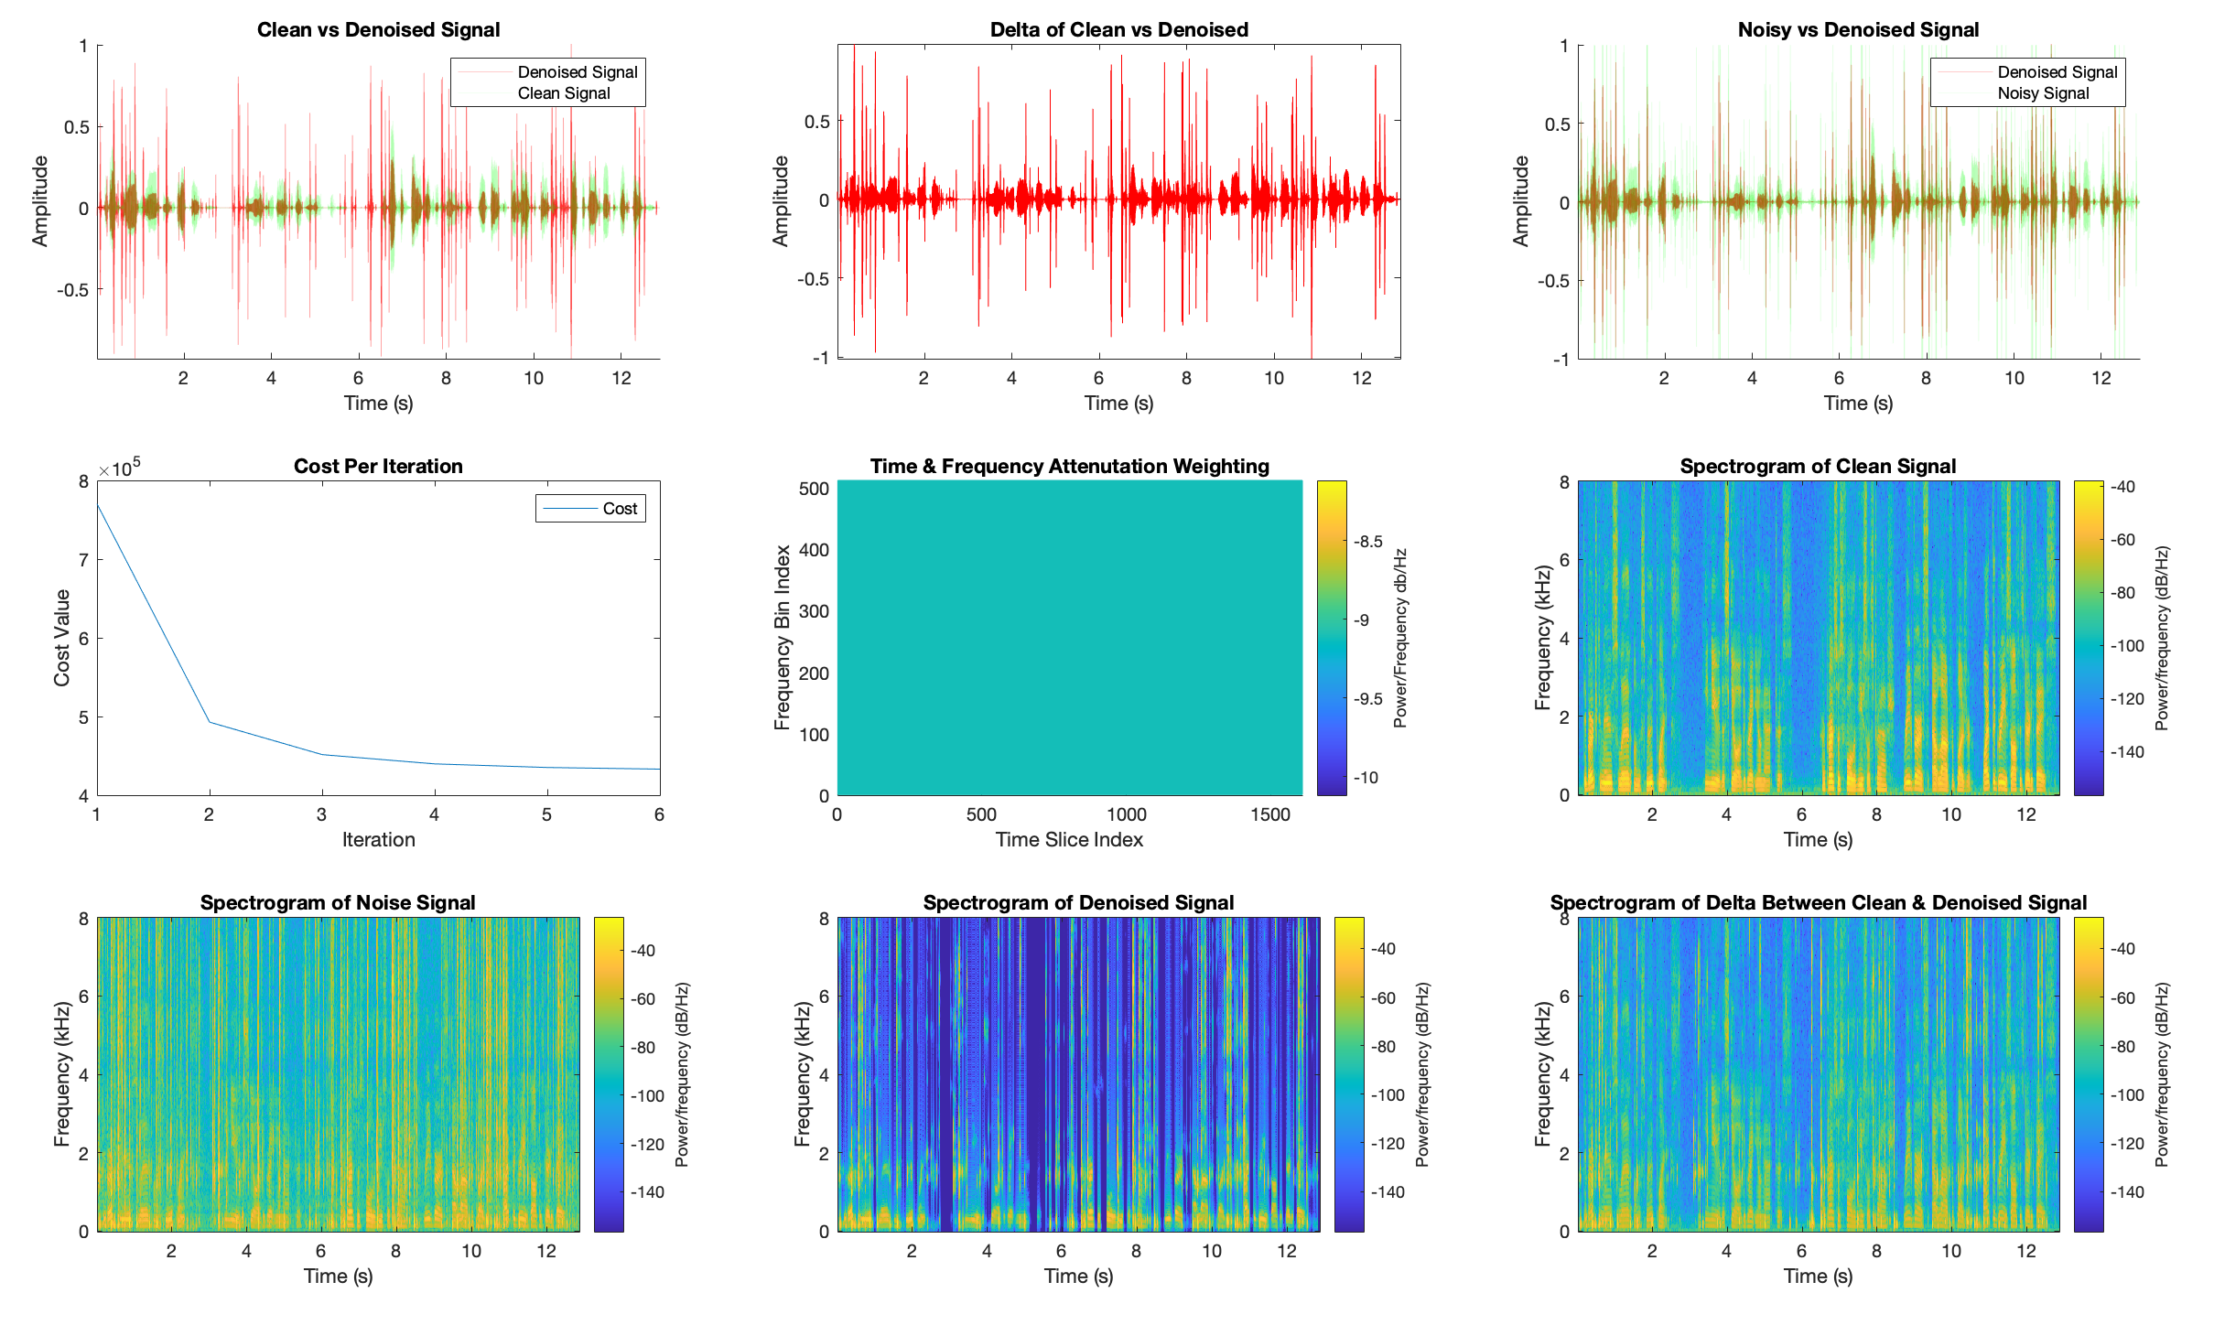
Impulsive Noise Visualization (OGS)

Slide 13
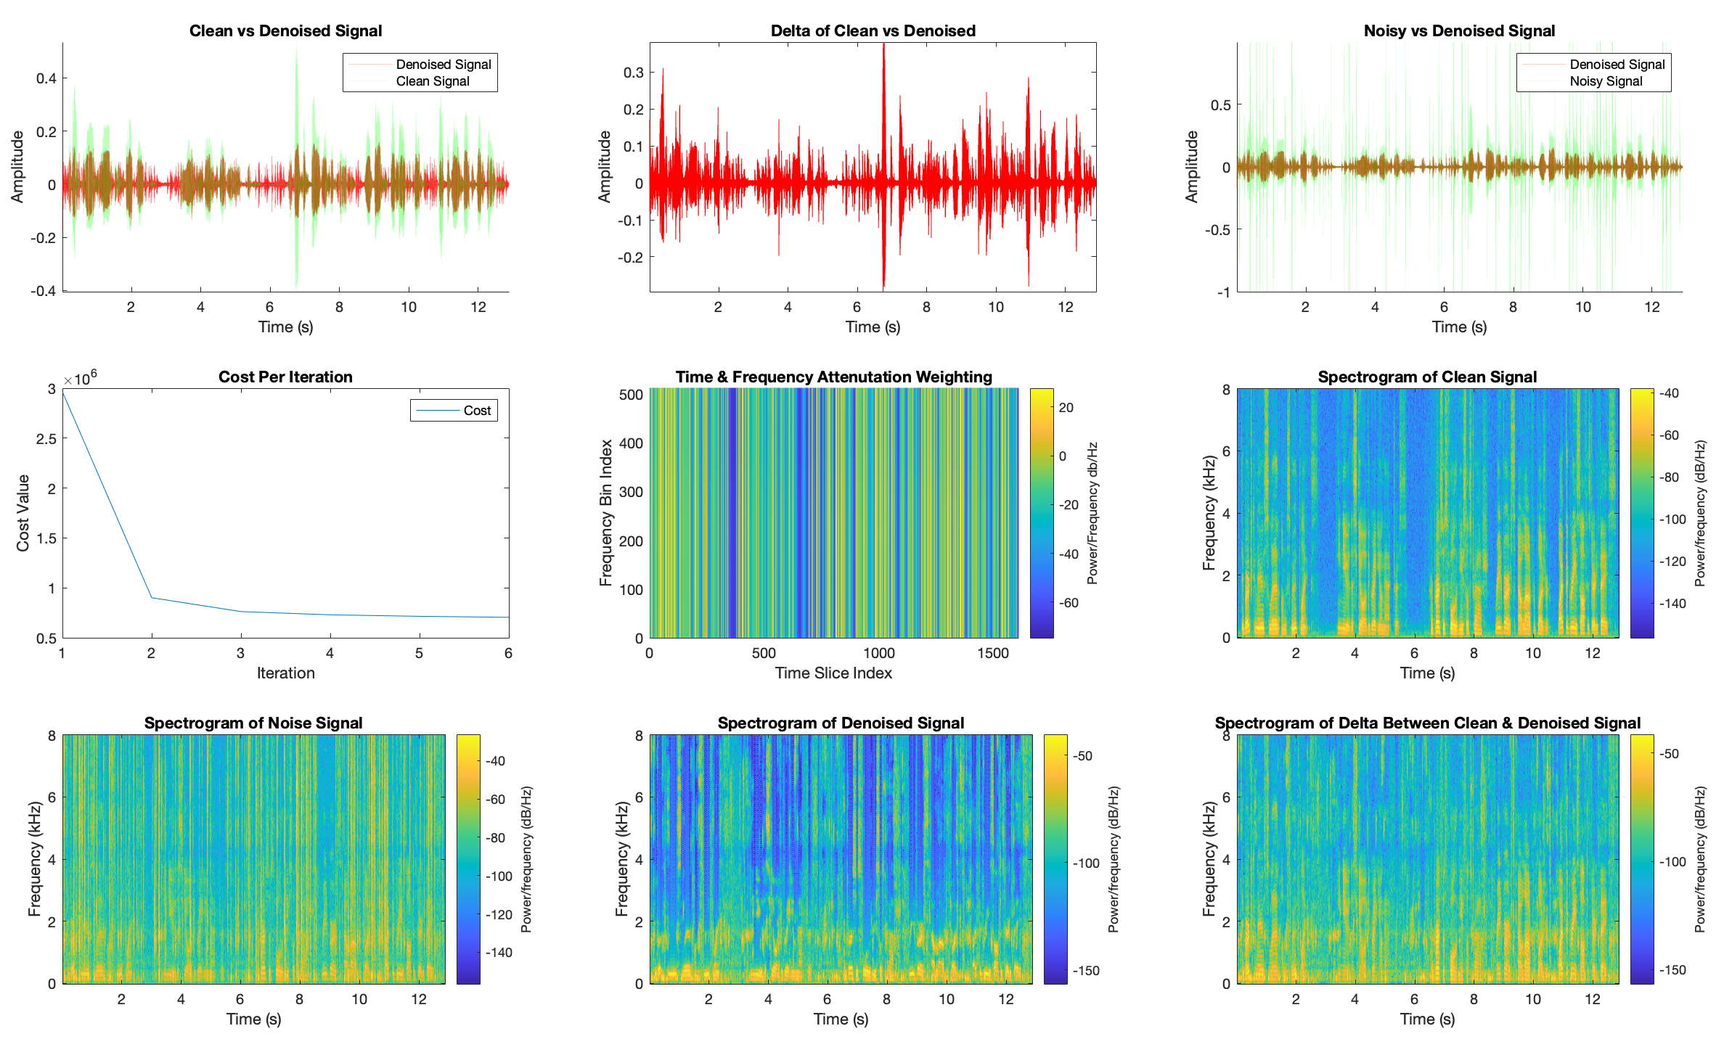
Impulsive Noise Visualization (TFOGS)

Slide 14
Future Work
Failed with Binary Time-Frequency Masking [could try adaptive masking]
Different time weighting schemes
More advanced filter design, perhaps adaptive filtering
Extension to impulsive + stationary noise
Better objective metric evaluation for speech intelligibility

